Slide 1
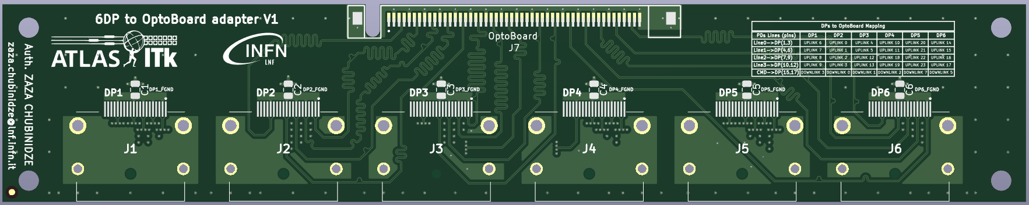
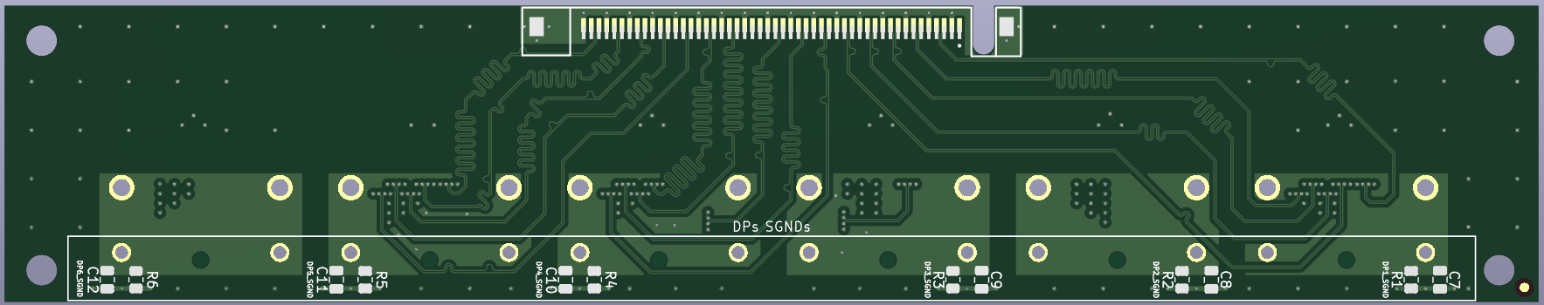
Single board PCB Design
6DP to OptoBoard Adapter Card
Top View
Bottom View

Slide 2
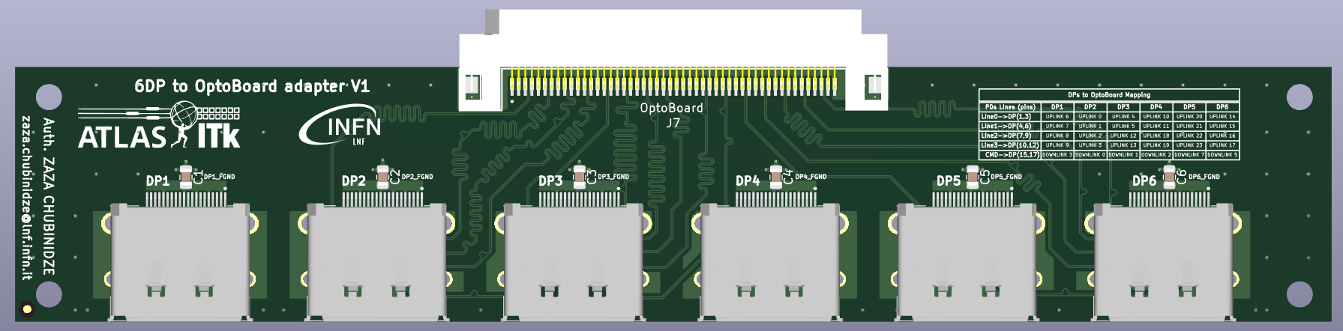
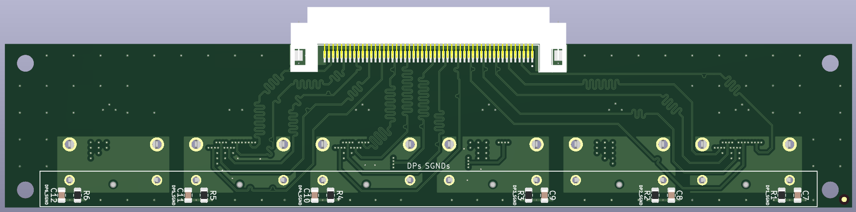
Single board Assembly
Top View
ERF8-050-01-L-D-EM2-TR connector
DP
DP
DP
DP
DP
DP
Bottom View
ERF8-050-01-L-D-EM2-TR connector

Slide 3
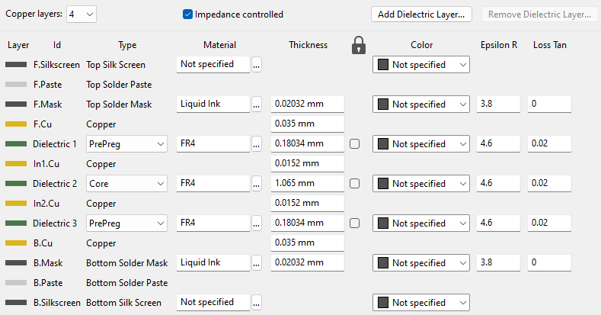
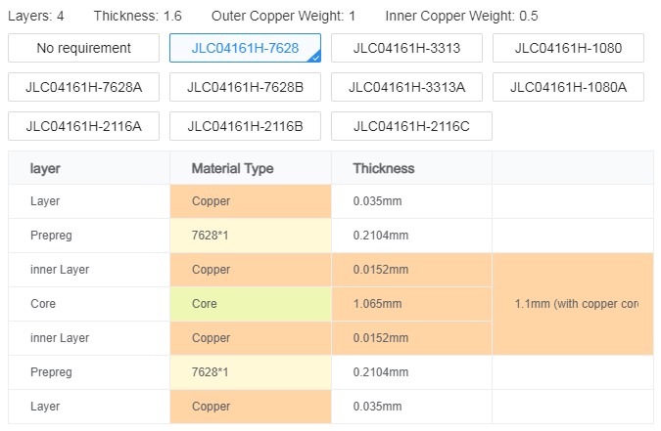
PCB production requirements
KiCAD PCB Layer StackUp
JLCPCB Standard
Components for assembly
C1, C2, C3, C4, C5, C6, C7, C8, C9, C10, C11, C12 --- 0.1uF SMD Capacitor (Package: C_0805)
R1, R2, R3, R4, R5, R6 --- 10K SMD Resistance (Package: R_0805)
J1, J2, J3, J4, J5, J6 --- DISPLAYPORT 20P SMD RA (Molex_472720024)
J7 --- ERF8-050-01-L-D-EM2-TR

Slide 4
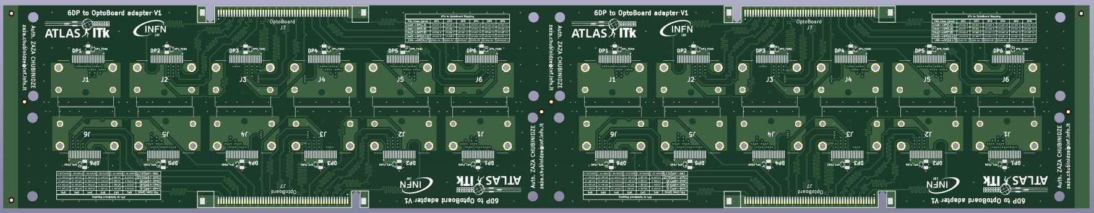
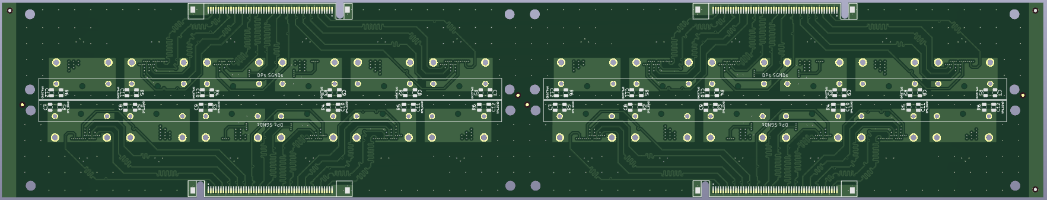
Panel design
Top View
Bottom View

Slide 5
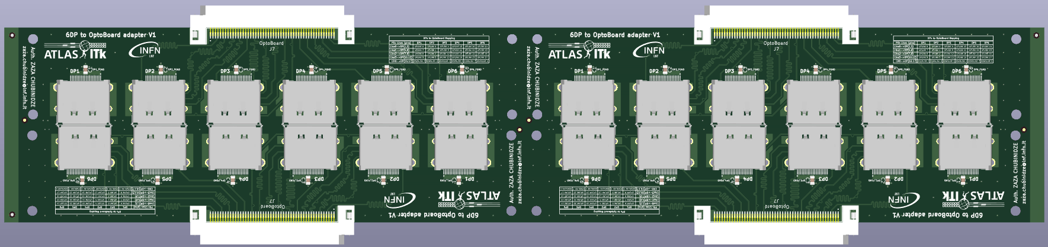
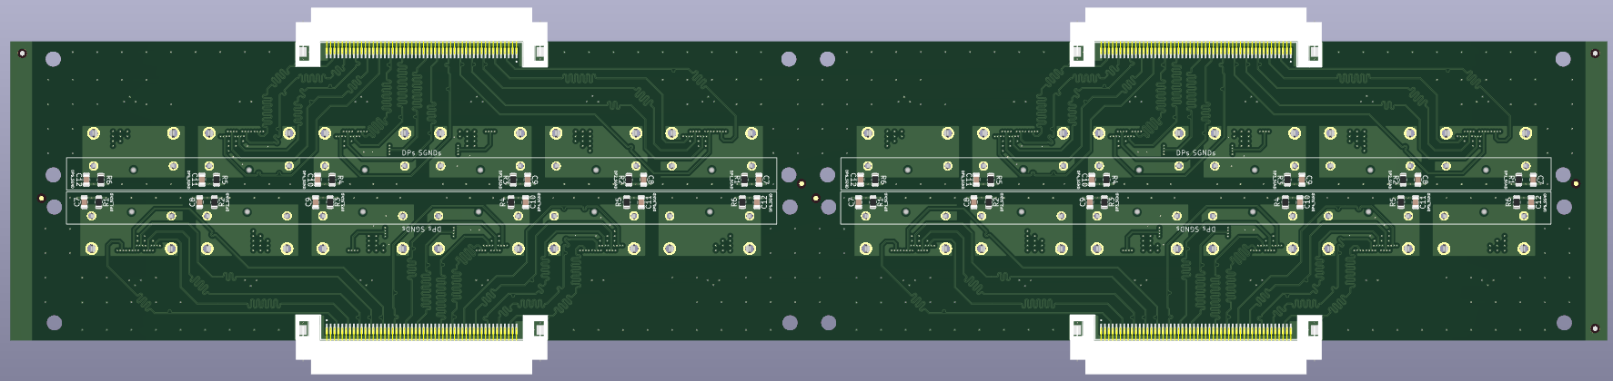
Panel assembly
Top View
ERF8-050-01-L-D-EM2-TR connector
ERF8-050-01-L-D-EM2-TR connector
DP
DP
DP
DP
DP
DP
DP
DP
DP
DP
DP
DP
DP
DP
DP
DP
DP
DP
DP
DP
DP
DP
DP
DP
ERF8-050-01-L-D-EM2-TR connector
ERF8-050-01-L-D-EM2-TR connector
Bottom View
ERF8-050-01-L-D-EM2-TR connector
ERF8-050-01-L-D-EM2-TR connector
ERF8-050-01-L-D-EM2-TR connector
ERF8-050-01-L-D-EM2-TR connector

